Slide 1

Biotech Student Management System
Team Members:
Kshitiz (24SBBS1170060)
Esha Sharma (24SBBS1170160)
Gyanendra Pandey (24SBBS1170008)
Suryansh Pratap Singh (24SBBS1170034)

Slide 2


Acknowledgement
I sincerely thank my Java teacher for their guidance and support in
completing this project. Your expertise helped us understand core concepts and implement this Student Management System effectively.
Special thanks to my team member for her valuable contribution, and for sticking together until the end.

Slide 3

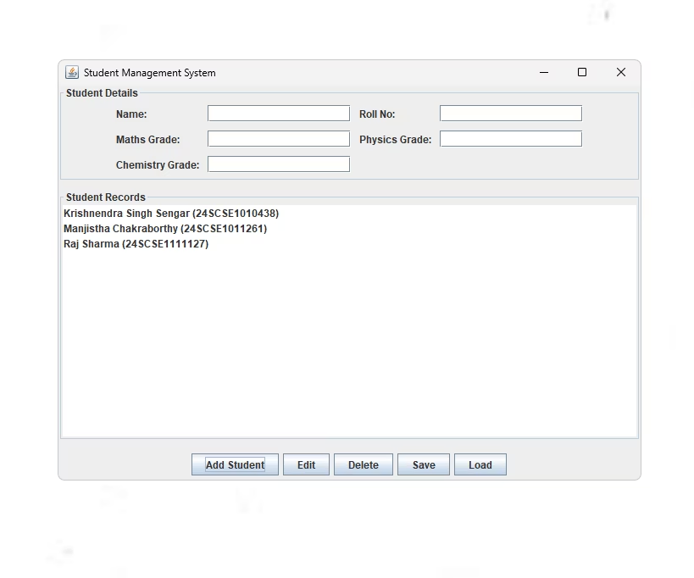

Project Overview
This Java project manages student records with grades and details.
It uses a graphical user interface built with Swing components.
Esha Sharma
Features
Add, edit, delete, save, and load student data.
Data Structure
Stores students with name, roll number, and subject grades.
Role-based Access
Teacher mode enables full control; student mode is view-only.

Slide 4


Student Class Design
Represents each student with name, roll number, and grades.
Implements Serializable for saving and loading data.
Attributes
Name
Roll Number
Subject Grades (Maths, Physics, Chemistry)
Methods
Getters and setters for all fields
toString method for display in list

Slide 5
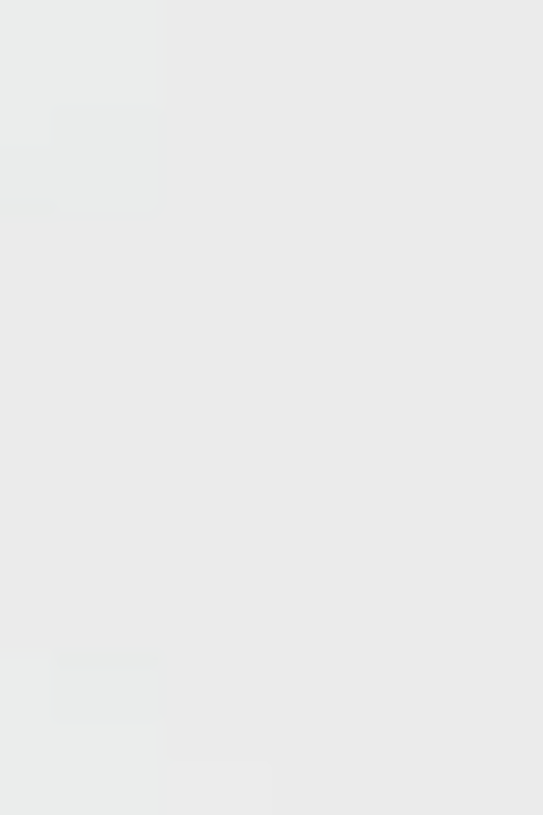
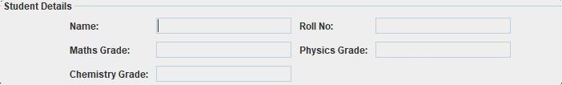
Graphical User Interface
Built with JFrame and Swing components.
Includes input fields, buttons, and a student list.
Input Fields
Name, Roll No, and grades for three subjects.
Buttons
Add, Edit, Delete, Save, Load functionalities.
Student List
Displays all student records dynamically.

Slide 6

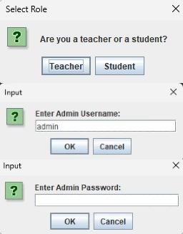


Role Selection and Security
Users select role: Teacher or Student at startup.
Teacher login requires username and password.
Teacher Mode
Full access with admin login.
Student Mode
Limited access without editing rights.

Slide 7



Core Functionalities
Add new students with complete details.
Edit and delete existing student records. Save all data to a file and load it later.
Add Student
Input validation ensures all fields are filled.
Edit Student
Select from list and update details.
Delete Student
Remove selected student from records.
Save € Load
Serialize data to file and reload as needed.

Slide 8



Data Handling and Persistence
Uses Java serialization to save and load student list.
Handles IO exceptions with user notifications.
Saving Data
Writes student list to "students.dat" file.
Loading Data
Reads student list from file and updates UI.

Slide 9
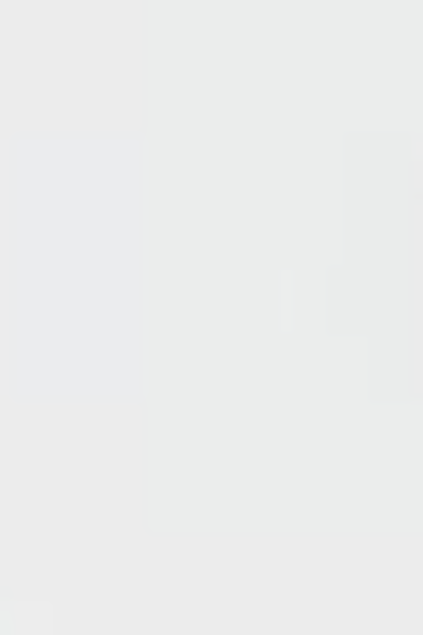
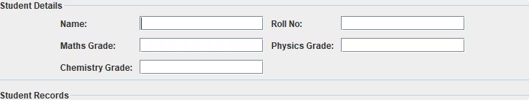
User Interaction and Validation
Input fields clear after operations for ease of use.
Selection in list fills input fields for editing.
Input Validation
Ensures no empty fields before adding or editing.
Field Clearing
Clears inputs after add, edit, or delete actions.
List Selection
Populates fields with selected student data.

